Slide 1
Blue Team
Ilhaam Ahmed, Jennifer Wark & Jamie Young
Notes:
Introduce ourselves - approx 15 secs

Slide 2

Task
20 databases
Data Transformation
Notes:
Jamie
Firstly I’ll explain the challenge we were set and the dataset we were working with. The data comes from a survey conducted in 2018 for the Programme for International Student Assessment (PISA). The survey questioned students, teachers, and parents on a variety of topics such as education and lifestyle. The data we worked with was a subset of this, using 20 countries. Each country had its’ own database which was being continuously updated to mimic real-time submissions. We were tasked with extracting and transforming some relevant information so that it could be displayed on a dashboard, which we’re going to walk you through in the next slide.

Slide 3

Notes:
Jamie

Slide 4
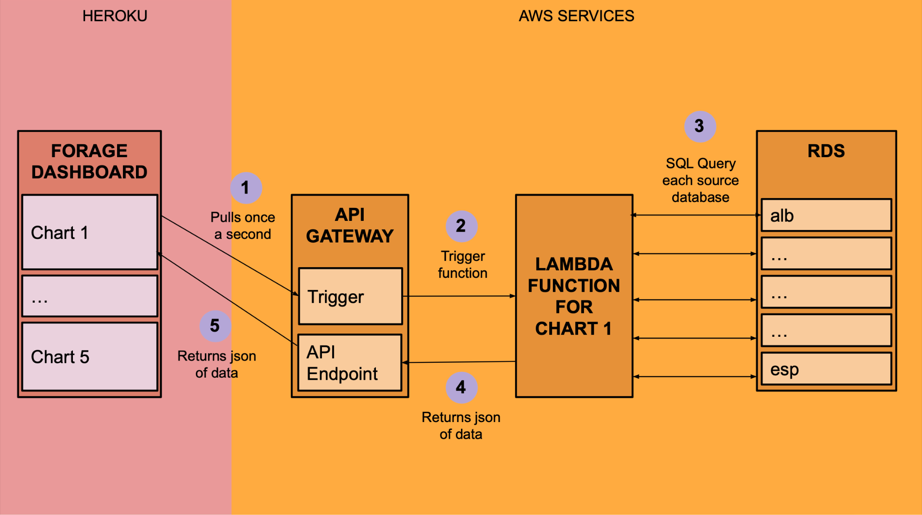
Solution
Notes:
Approx. time - 1 min 40secs
Jenny
Flow chart Explanation:
Each chart we just saw on the dashboard has a flow chart like this apart from one that is more complicated, more on that in a minute.
The charts are on the left and the dashboard is the only piece that isn’t an AWS service.
Every second each chart on the dashboard tries to get data from the URL we input.
When this happens our code is triggered to run to retrieve this data, our data processing code is in the lambda
The lambda function connects to each of the databases and extracts data for each country. Examples albania to spain. RDS is a service that stores the databases on amazon servers. The code can further manipulate this data.
The lambda function returns the data in json form to the URL
The dashboard can now collect that data and display a chart
Total time varies from chart to chart but is approx. 2 secs

Slide 5
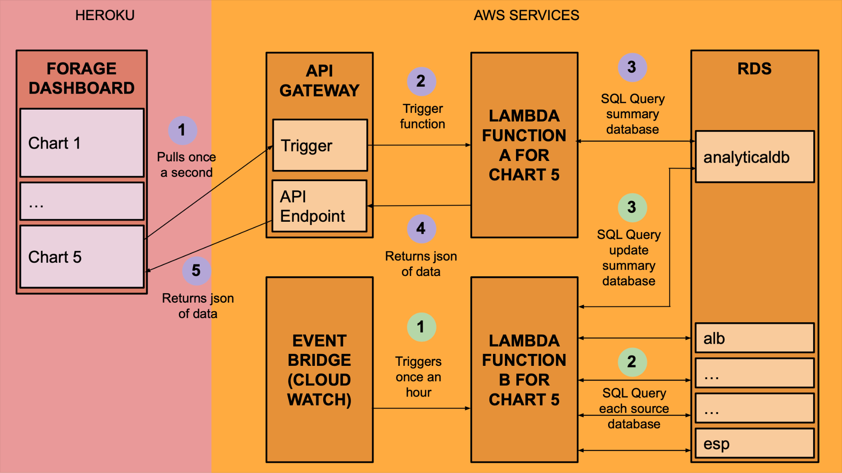
Notes:
For the hourly submissions chart we needed a more complex process.
As we only wanted to update every hour with the new number for that hour we didn’t want to go through the databases every second.
We did this a different way using an additional function to update a summary database which the data could be drawn from each second.

Slide 6



Why did we choose our approach?
AWS Lambda:
Data manipulation
API Gateway:
Provides API access
EventBridge (CloudWatch Events):
Allows automation
Notes:
Approx. 1 min 30 secs
Ilhaam
AWS Lambda:
After doing some group discussions and research on what the best approach would be, we decided to go with Lambda. We were looking for simplicity in setup and maintenance, and with Lambda you can easily run simple jobs that do what you want.
A Lambda function in AWS is a piece of code that is executed in response to an event. In our case the event was a request to an API endpoint.
We chose Lambda as it’s serverless, easily scalable and it integrates with API Gateway.
API Gateway:
We added API Gateway triggers to each of our Lambda functions in order to create APIs with HTTP endpoints.
This allowed us to get URLs that can be accessed in our Forage dashboard. API Gateway is designed to provide low latency for API requests, this just means that the data in our dashboard will be seen in real-time, which was the goal of our task.
EventBridge (CloudWatch Events):
One of our charts requested a count of hourly submissions, so we used EvmentBridge to trigger our Lambda function each hour and send an hourly submission count to one of our databases. This allowed us to efficiently automate this task.
NON-TECHNICAL EXPLANATION:
An easier way to understand this approach is: If you think of AWS Lambda as a team of automatic data fetchers. They gather the latest information from our different data sources and pass the result to our dashboard. This ensures that the dashboard is always showing real-time data without us having to manage loads of complicated systems.

Slide 7


Working Together
Open Communication
Problem Solving
Adaptability
Notes:
Jamie
After our initial meeting where we decided on our AWS based approach we then worked as a trio to complete the first two charts. This worked well as we were figuring out and learning what was required together. While working in this way we were able to create a constructive environment where we all felt comfortable putting ideas forward. This meant when we ran into problems, as a team we were able to come up with a few different potential solutions and we were never stuck for long. We then split off to work on the remaining three charts separately but even during this ‘solo’ time we would come together to work through any issues we encountered.

Slide 8

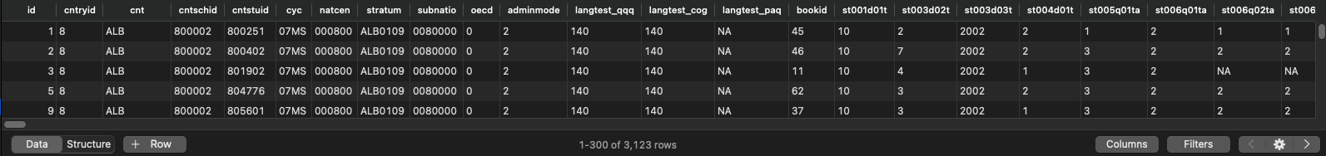
Overcoming Problems
Large dataset
Links between services
Notes:
Jenny
Approx. time - 35 secs
The huge number of data columns made it difficult to find which information was relevant. -> We had to be flexible and have open minds to different ways of working, keep checking back with the information given. At first we tried to summarise all the columns but realised this wasn’t time efficient and switched tactic.
We used table plus to look at and run SQL queries on the RDS databases as we were working to check we were getting the desired results.
There was a lot of work figuring out all of the links to various AWS services and the settings required, there was a lot of information to learn so that we could apply it. -> We researched with a different number of people depending on how much of a blocker the issue was and pooled information, looking at the documentation and talking through our understanding.
Overall, the initial approach we chose was good and the services are designed to work together so once we really got started the problems were solved quickly.

Slide 9

What We Learned
AWS Services
Manipulating Large Dataset
Data Engineering pipelines
Decision Making
Notes:
Ilhaam
Approx. time - 30 secs
In this project we learnt a lot about AWS and how it’s different services work together.
All three of us have used some of these services previously on the course so in this project we were able to build on our knowledge, as well as learn new things, for example with the use of API gateways and other services. This gave us a lot more confidence with AWS.
But mostly we learnt how to use efficient data engineering pipelines to enable seamless data transformation and processing.
We also learnt the importance of making informed data engineering decisions. For example, the specification for one of our charts asked that the sense of belonging values be standardised from 0 to 50. But after trying this approach we quickly realised it would make more sense to calculate an average instead.
As Jenny mentioned the dataset we used was very large and updating constantly, so it was a great learning opportunity for the three of us to work with this dataset.
Note: Course Objectives
Ability to operate at any point in the data life cycle, with special focus on the storage and processing of data
Applied skills in secure, tested data storage, batch, and stream processing
Applied skills in the management and monitoring of data pipelines
Facility with modern Cloud technologies such as AWS

Slide 10

Questions

